Slide 1

Student Name
V AISHWARYA
FINAL PROJECT
3/21/2024 Annual Review
1

Slide 2

PROJECT TITLE
KEYLOGGER AND SECURITY
3/21/2024 Annual Review
2

Slide 3





AGENDA
INTRODUCTION TO KEYLOGGERS AND SECURITY
PROBLEM STATEMENT
PROJECT OVERVIEW
END USERS
SOLUTION AND VALUE PREPOSITION
THE “WOW” FACTOR IN OUR SOLUTION
MODELLING
RESULT
CONCLUSION
3/21/2024 Annual Review
3

Slide 4

PROBLEM STATEMENT
#
Keyloggers are malicious software programs or hardware devices that covertly monitor and record every keystroke made on a computer. Keyloggers represent a significant cybersecurity threat, aiming tocovertly capture keystrokes to steal sensitive information, compromise personal and organizational data, and facilitate further malicious activities. Their stealthy nature and the diverse methods of deployment make them challenging to detect and mitigate, resulting in substantial privacy, financial, and reputational impacts.
Breakdown of the Problem Statement
Covert Capture of Keystrokes
Theft of Sensitive Information
Key Aspects to Address
User Education and Awareness:
Detection and Removal:
3/21/2024 Annual Review
4

Slide 5

PROJECT OVERVIEW
Keyloggers, a type of surveillance technology, pose a significant threat in the realm of cybersecurity. Designed to record every keystroke made on a device, they capture sensitive information and relay it to malicious actors, leading to severe security breaches and data theft.
software keylogger.
hardware keylogger.
Keyloggers can be installed through various methods, including phishing emails, malicious downloads, drive-by downloads from compromised websites, and physical installation by an attacker with access to the device. Once installed,keyloggersoperate stealthily, recording keystrokes and often hiding from standard detection tools by using advanced techniques like rootkits and encryption.
3/21/2024 Annual Review
5

Slide 6

WHO ARE THE END USERS?
Uses of Keyloggers
Malicious Uses.
Legitimate Uses.
1. Cybercriminals
Motivation: Financial gain, identity theft, unauthorized access.
2. Corporate Espionage Agents
Motivation: Competitive advantage, intellectual property theft.
3. Government and Intelligence Agencies
Motivation: National security, surveillance.
4. Employers
Motivation: Monitoring, productivity tracking.
5. Individuals
Motivation: Personal security, self-monitoring.
3/21/2024 Annual Review
6

Slide 7
WHO ARE THE END USERS?
Ethical and Legal Considerations
**1. Legitimacy and Consent:
Transparency: Legitimate use of keyloggers, especially by employers and parents, generally requires transparency and, in many jurisdictions, the consent of the monitored individuals.
Legal Compliance: Users must comply with laws and regulations regarding privacy and surveillance, which vary by region and context. Unauthorized use of keyloggers can lead to severe legal consequences.
**2. Privacy Concerns:
Invasion of Privacy: The use of keyloggers can lead to significant privacy violations, particularly if used without the knowledge and consent of the target. This raises ethical concerns about the balance between surveillance and privacy.
**3. Security Risks:
Data Security: Even legitimate users must ensure that the data captured by keyloggers is securely stored and protected from unauthorized access. Breaches of this data can have severe repercussions.
3/21/2024 Annual Review
6

Slide 8


YOUR SOLUTION AND ITS VALUE PROPOSITION
1. Advanced Detection and Removal Tools
2. Encryption and Secure Communication
3. Multi-Factor Authentication (MFA)
4 .User Education and Awareness
5. System and Network Hardening
6. Incident Response and Recovery
3/21/2024 Annual Review
7

Slide 9
YOUR SOLUTION AND ITS VALUE PROPOSITION
Solution:
Antivirus and Anti-Malware Software: Regularly updated security software can detect and remove known keyloggers. These tools use signature-based and heuristic analysis to identify malicious software.
Data Encryption: Encrypting sensitive data both at rest and in transit ensures that even if keystrokes are captured, the information remains unreadable to unauthorized parties.
Value Proposition:
Proactive Protection: Continuous monitoring and advanced detection mechanisms help in identifying and neutralizing keyloggers before they can cause significant harm.
Data Confidentiality: Encryption ensures that sensitive information remains confidential and secure from interception by keyloggers.
3/21/2024 Annual Review
7

Slide 10

THE WOW IN YOUR SOLUTION
The WOW Solution Keylogger is a comprehensive, multi-faceted approach designed to address the threat of keyloggers in cybersecurity effectively.This solution combines advanced technology, robust policies, and proactive measures to create a secure digital environment. Here’s an in-depth look at the WOW Solution Keylogger:
1.Wholistic Detection and Removal.
2.Optimized Encryption and Secure Communication.
3.Wide Adoption of Multi-Factor Authentication (MFA).
4. Well-Rounded User Education and Awareness.
5. Robust System and Network Hardening.
6. Winning Incident Response and Recovery.
3/21/2024 Annual Review
8

Slide 11
MODELLING
Modelling keyloggers involves understanding their structure, behavior, and deployment methods. This process helps in developing effective detection and mitigation strategies. Below is a detailed model covering various aspects of keyloggers:
Keylogger Architecture Components:
Capture Component: The core part that intercepts and records keystrokes.
Storage Component: Temporarily stores captured data on the infected device.
Transmission Component: Sends the recorded data to the attacker, typically via email, FTP, or a web server.
Stealth Mechanisms: Techniques used to avoid detection, such as rootkits, process injection, and encryption.
Keylogger Lifecycle:
1. Deployment:
Phishing Attacks: Delivered via malicious email attachments or links.
MalwareDownloads: Embedded in software downloads from untrusted sources.
Physical Access: Installed directly onto a device through physical access.
3/21/2024 Annual Review
9

Slide 12
MODELLING
2. Activation:
System Boot/Startup: Automatically starts with the system or specific applications.
UserActions:Activated by specific user actions or when certain applications are opened.
3. Data Capture:
Keystroke Logging: Records every keystroke made by the user.
Screen Capturing: Some keyloggers also capture screenshots or video recordings.
Clipboard Monitoring: Monitors and captures data copied to the clipboard.
4. Data Storage:
Local Storage: Temporarily stores data on the infected device.
Stealth Storage: Uses hidden files or encrypted formats to avoid detection
5. Data Transmission:
Periodic Transmission: Sends captured data at regular intervals.
Trigger-Based Transmission: Sends data when specific conditions are met, such as network availability.
3/21/2024 Annual Review
9

Slide 13
MODELLING
6. Stealth Techniques:
Rootkits: Hides the keylogger’s presence from detection tools.
Encryption: Encrypts captured data and communication to avoid detection.
Process Injection: Injects itself into legitimate processes to evade detection.
The best way to protect your devices from keylogging is to use a high-quality antivirus or firewall. You can also take other precautions to make an infection less likely.
You may use a password manager to generate highly complex passwords—in addition to enabling you to see and manage your passwords. In many cases, these programs are able to auto-fill your passwords, which allows you to bypass using the keyboard altogether.
some extensions to access your extensions in some of the most common browsers:
Safari: Choose "Preferences" in the Safari menu and click on "Extensions."
Chrome: Go to the address field and type "chrome://extensions."
Opera: Choose "Extensions," then select "Manage Extensions."
Firefox: Enter "about: addons" in the address field.
Microsoft Edge: Select "Extensions" in your browser menu.
Internet Explorer: Go to the Tools menu and choose "Manage add-ons
3/21/2024 Annual Review
9

Slide 14
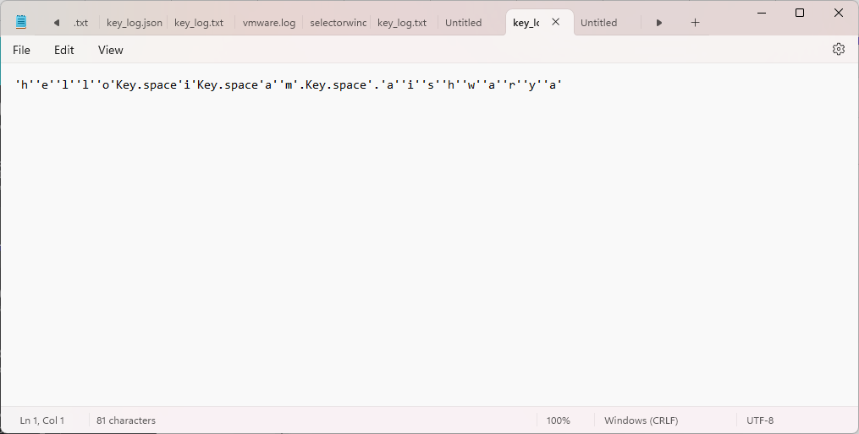
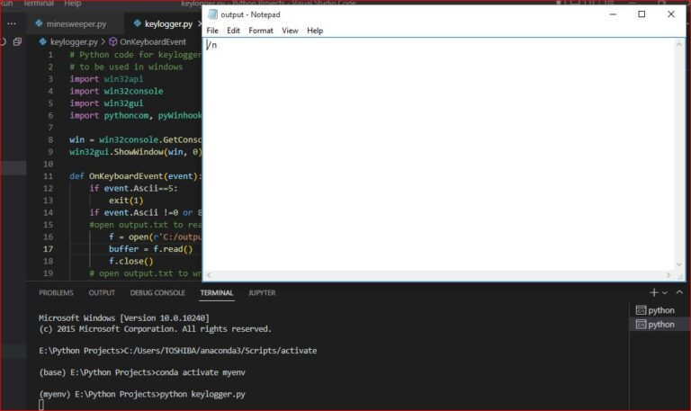

RESULTS
keyloggers represent a double-edged sword, with legitimate applications for monitoring and oversight, but also posing significant security risks when exploited for malicious purposes. Vigilance, education, and robust security measures are essential for mitigating these risks and protecting against the harmful effects of keyloggers on security and privacy
3/21/2024 Annual Review
10

Slide 15

CONCLUSION
Keyloggers, while valuable in certain legitimate scenarios, pose significant risks when used maliciously. Mitigating these risks requires a combination of robust security measures, user education, and adherence to privacy laws. Vigilance and proactive security practices are essential to protect sensitive information and maintain privacy in the face of evolving keylogger threats.
3/21/2024 Annual Review
10

Slide 16
PROJECT LINK
https://github.com/aishu-v1717/keylogger.git
3/21/2024 Annual Review
10

Slide 17
THANK YOU
3/21/2024 Annual Review
10

